Slide 1
Fundamentals of Algorithms
Textbook Section 1.1-1.3

Slide 2
Announcements
Questions on HW1?

Slide 3
What Is An Algorithm?
“An algorithm is a sequence of unambiguous instructions for solving a problem, i.e., for obtaining a required output for any legitimate input in a finite amount of time.”
An algorithm is “not an answer but specific instructions for getting an answer” to a problem.

Slide 4
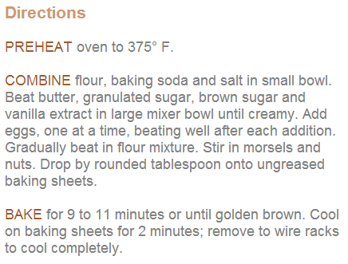
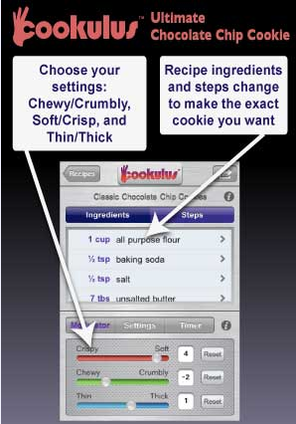
What Is An Algorithm?
“An algorithm is a sequence of unambiguous instructions for solving a problem, i.e., for obtaining a required output for any legitimate input in a finite amount of time.”
Notes:
Commonly represented in pseudo-code

Slide 5
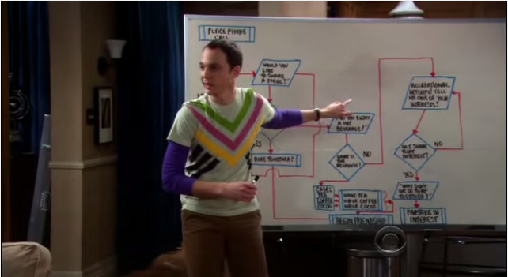
What Is An Algorithm?
“An algorithm is a sequence of unambiguous instructions for solving a problem, i.e., for obtaining a required output for any legitimate input in a finite amount of time.”
Notes:
Consider exactly what range of inputs algorithm should work for – testcase types??

Slide 6
Algorithmic Problem Solving
Understand the Problem
Decide on Computational Means
Design an Algorithm
Prove Correctness
Analyze Algorithm
Write Code

Slide 7
Algorithmic Problem Solving
Understand the Problem
Do small examples by hand
Specify range of valid inputs incl. boundary cases
Can existing algorithm be used?

Slide 8
Algorithmic Problem Solving
Decide on Computational Means
Sequential or Parallel?
Exact or Approximate?
Speed or Memory Limitations?

Slide 9
Algorithmic Problem Solving
Design an Algorithm
Will learn approaches this semester!
Choose appropriate data structure
Specify algorithm:
Natural Language (ambiguous)
Pseudocode (most common)
Flowchart

Slide 10
Algorithmic Problem Solving
Prove Correctness
Prove that algorithm yields required result for every valid input in finite time.
Proof by Induction well suited
Single incorrect instance enough to disprove.
Approximate algorithms seek to prove answer is within finite bound of optimal.

Slide 11
Algorithmic Problem Solving
Analyze Algorithm
Beyond correctness, concerned with:
Time Efficiency
Space Efficiency
Simplicity
Generality: problems solved / sets of input accepted

Slide 12
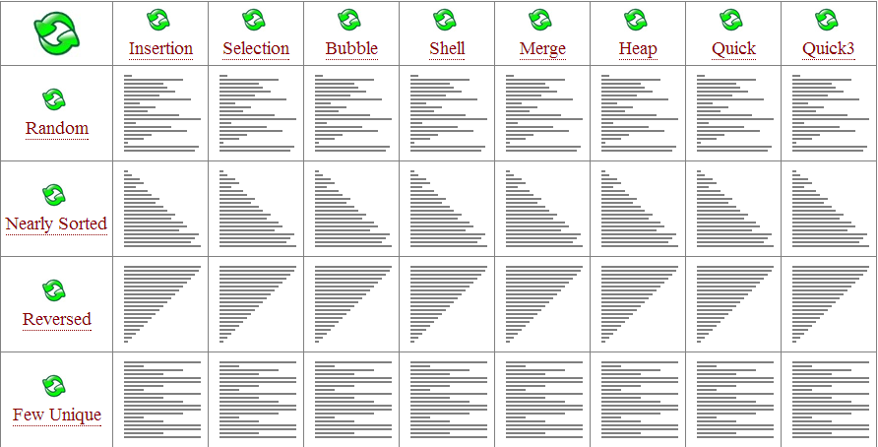
Multiple Algs for Same Problem
May solve the problem with dramatically different speeds.

Slide 13
Algorithmic Problem Solving
Write Code
Good algorithm – order of magnitude difference
Good code implementation – 10-50% speedup
Compute invariants outside loop, store common sub-expressions, choose cheap over expensive operations, etc. See The Practice of Programming and Programming Pearls

Slide 14
Important Problems
Sorting
Searching
String Processing
Graph Problems
Combinatorial Problems
Geometric Problems
Numerical Problems

Slide 15
Sorting
Arrange items of list in non-decreasing order
Want sorted output / make search quicker / step in larger alg.
Best possible: O(n log₂n)
No alg. best in all situations – some simple but slow, some best on randomly ordered input, some only work in RAM
Stable if equal items remain in orig. order
In-place if does not require more memory

Slide 16
Searching
Find given key in a set
No best alg: simple sequential, fast but limited binary, more complex data structures, more memory
May need to balance search with add/remove

Slide 17
String Processing
String is sequence of chars from an alphabet
Text strings
Bit strings
Gene sequences
String matching: searching for given word in sequence of text.

Slide 18
Graph Problems
Collection of points (vertices) connected by line segments (edges)
Model wide variety of apps: internet, transportation, communication, social/economic networks, project scheduling, games.
TSP: route planning, VSLI chip layout, etc.
Graph-Coloring: scheduling

Slide 19
Combinatorial Problems
Find a combinatorial object – permutation, combination, subset – that satisfies constraints.
TSP, graph coloring examples
Most difficult problems in CS.
Number of objects grows rapidly with problem size.
No known algs for solving exactly in finite time (P vs. NP)

Slide 20
Geometric Problems
Deals with points, lines and polygons
Useful in graphics, robotics and tomography
Closest-Pair: given n points find closest pair
Convex-Hull: find smallest convex polygon that contains all points in a set.

Slide 21
Numerical Problems
Systems of equations, definite integrals, evaluating functions, etc.
Majority can only be solved approximately
Require manipulating real #’s which can only be represented approximately
Can lead to accumulation of errors
Still useful in scientific and engineering applications.

Slide 22
Analysis of Algorithms

Slide 23
Algorithmic Problem Solving
Analyze Algorithm
Beyond correctness, concerned with:
Time Complexity
Space Complexity
Beyond what is needed to represent input/output
Simplicity
Generality: problems solved / sets of input accepted
Time/space can be measured.
Time & memory traditionally limited.
Time amenable progress.

Slide 24
Measuring Input Size, n*
Algs run longer on larger input.
Size:
Sometimes clear: list length, deg. of polynomial
What about a n x n matrix? n or N?
What about text processing? Letters or words?
What if input is one integer?
Notes:
* Some algorithms need more than one input size variable

Slide 25
Measuring Running Time
Using msec. dependent on H/W, implementation, compiler
Count basic operations – operation that contributes most to runtime – often most time-consuming op of innermost loop
Ignores non-basic operations
Focus on order of growth for large input, why?

Slide 26
Orders of Growth
What happens when you double the input size (n)?
O(1)
O(log₂n)
O(n)
O(n²)
O(n³)
O(2^{n})

Slide 27
Worst, Best and Average Case
What is efficiency of linear search?
LinearSearch(A[0…n-1], K)
i ← 0
while i < n and A[i] ≠ K do
i ← i + 1
if i < n
return i
else
return -1

Slide 28
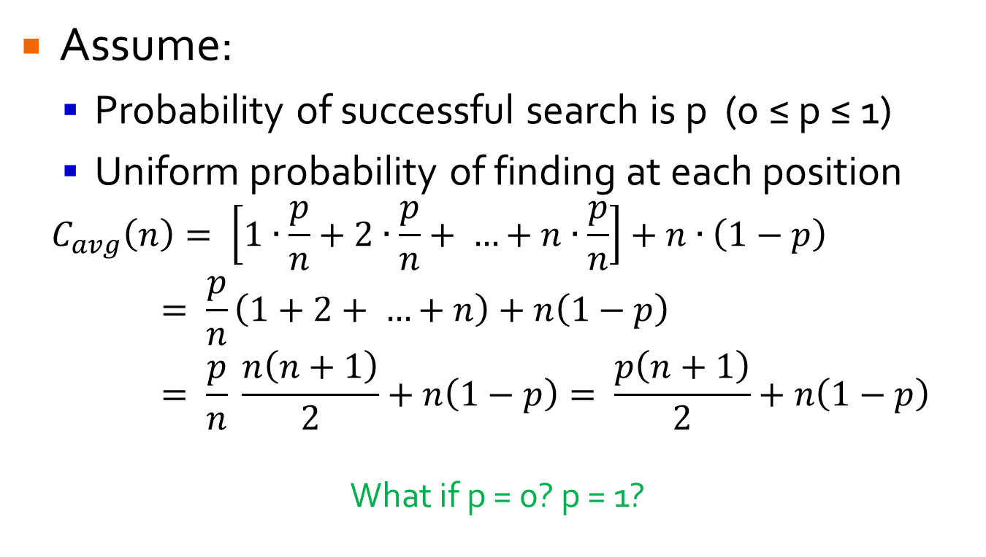
Average Case
Assume:
Probability of successful search is p (0 ≤ p ≤ 1)
Uniform probability of finding at each position
$$C_{avg}\left(n\right)= \left[1∙\frac{p}{n}+2∙\frac{p}{n}+ …+n∙\frac{p}{n}\right]+n∙\left(1−p\right)= \frac{p}{n}\left(1+2+ …+n\right)+n\left(1−p\right)= \frac{p}{n} \frac{n\left(n+1\right)}{2}+n\left(1−p\right)= \frac{p\left(n+1\right)}{2}+n\left(1−p\right)$$
What if p = 0? p = 1?

Slide 29
Worst, Best and Average Case
Worst Case: guarantees runtime will never exceed C_{worst}(n)
Best Case: if (near) best input covers useful instances, can be worth knowing C_{best}(n)
e.g. Sorting mostly sorted list
Avg. Case: hard to obtain, but important because worst case may be overly pessimistic
Amortized: single op may be expensive, but less so for each subsequent one.

